Slide 1
Chapter 02
Assembler

Slide 2
Role of Assembler
Source
Program
Assembler
Object
Code
Linker
Executable
Code
Loader

Slide 3
Introduction to Assemblers
Fundamental functions
translating mnemonic operation codes to their machine language equivalents
assigning machine addresses to symbolic labels used by the programmer
Machine dependency
different machine instruction formats and codes

Slide 4
Example Program (Fig. 2.1)
Purpose
The main routine reads records from input device (code F1)
copies them to output device (code 05)
The main routine calls subroutine RDREC to read a record into the buffer and subroutine WRREC to write a record from the buffer to the o/p device

Slide 5
The end-of-record marked with NULL char(00)
If (size(rec) > len(buff) ) only 1st 4096 bytes are copied
at the end of the file, writes EOF on the output device, then RSUB to the operating system
Lines beginning with dot (.) represents Comment
Line number are just for your reference
program

Slide 6
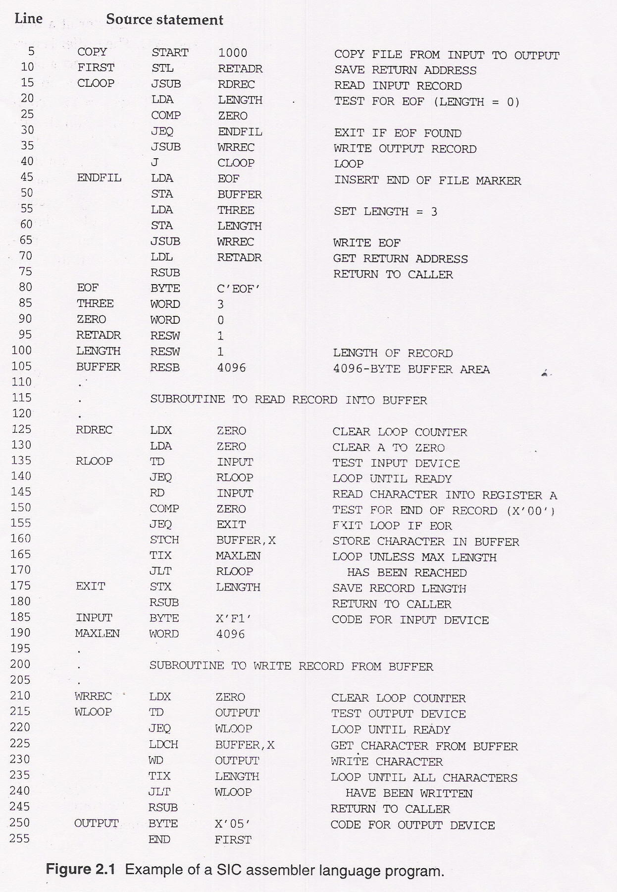

Slide 7
Figure 2.1 (Pseudo code)
Program copy {
save return address;
cloop: call subroutine RDREC to read one record;
if length(record)=0 {
call subroutine WRREC to write EOF;
} else {
call subroutine WRREC to write one record;
goto cloop;
}
load return address
return to caller
}

Slide 8
An Example (Figure 2.1, Cont.)
EOR:
character x‘00’
Subroutine RDREC {
clear A, X register to 0;
rloop: read character from input device to A register
if not EOR {
store character into buffer[X];
X++;
if X < maximum length
goto rloop;
}
store X to length(record);
return
}

Slide 9
An Example (Figure 2.1, Cont.)
Subroutine WDREC {
clear X register to 0;
wloop: get character from buffer[X]
write character from X to output device
X++;
if X < length(record)
goto wloop;
return
}

Slide 10
Assembler Directives
Pseudo-Instructions
Not translated into machine instructions
Providing information to the assembler
Basic assembler directives
START
END
BYTE
WORD
RESB
RESW

Slide 11
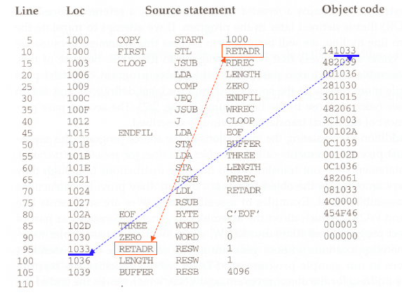

Slide 12
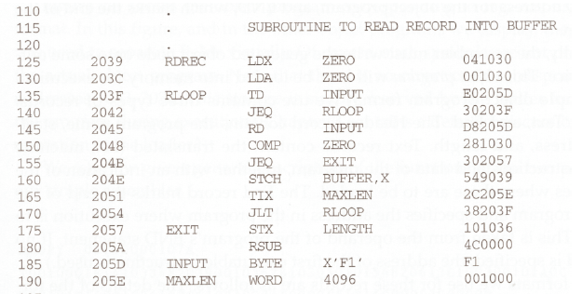

Slide 13
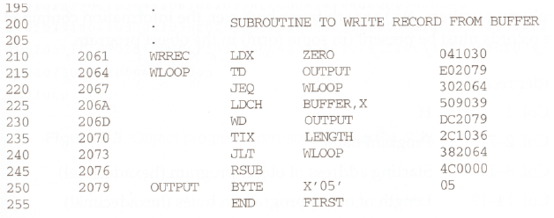

Slide 14
Assembler’s functions
Convert mnemonic operation codes to their machine language equivalents
Ex Translate STL to 14 (line no 10)
Convert symbolic operands to their equivalent machine addresses
Ex: RETADR TO 1033 (line no 10)
Build the machine instructions in the proper format
Convert the data constants to internal machine representations
Translate EOF to 454F46 (line no 80)
Write the object program and the assembly listing

Slide 15
Difficulties: Forward Reference
Forward reference: reference to a label that is defined later in the program.
Loc Label Operator Operand
1000 FIRST STL RETADR
1003 CLOOP JSUB RDREC
… … … … …
1012 J CLOOP
… … … … …
1033 RETADR RESW 1

Slide 16
Because of forward reference most assemblers make two passes over the source program
In addition the assembler must process assembler directives
The assembler must write the generated object code onto some o/p device. This object code later loaded to memory for execution
The simple object program format consist of 3 types of records

Slide 17
Object Program Format
Header Record
Col. 1 H
Col. 2~7 Program name
Col. 8~13 Starting address (hex)
Col. 14-19 Length of object program in bytes (hex)

Slide 18
Object Program Format
Text Record
Col.1 T
Col.2~7 Starting address in this record (hex)
Col. 8~9 Length of object code in this record in bytes (hex)
Col. 10~69 Object code (69-10+1)/6=10 instructions
End Record
Col.1 E
Col.2~7 Address of first executable instruction (hex)
(END program_name)

Slide 19
Fig. 2.3
H COPY 001000 00107A
T 001000 1E 141033 482039 001036 281030 301015 482061 ...
T 00101E 15 0C1036 482061 081044 4C0000 454F46 000003 000000
T 002039 1E 041030 001030 E0205D 30203F D8205D 281030 …
T 002057 1C 101036 4C0000 F1 001000 041030 E02079 302064 …
T 002073 07 382064 4C0000 05
E 001000

Slide 20
Two Pass Assembler
Pass 1
Assign addresses to all statements in the program
Save the values assigned to all labels for use in Pass 2
Perform some processing of assembler directives
Pass 2
Assemble instructions
Generate data values defined by BYTE, WORD
Perform processing of assembler directives not done in Pass 1
Write the object program and the assembly listing

Slide 21
Two Pass Assembler
Read from input line
LABEL, OPCODE, OPERAND
Source
program
Intermediate
file
Object
codes
Pass 1
Pass 2
OPTAB
SYMTAB
SYMTAB

Slide 22
Data Structures
Operation Code Table (OPTAB)
Symbol Table (SYMTAB)
Location Counter(LOCCTR)

Slide 23
OPTAB (operation code table)
Content
menmonic, machine code (instruction format, length) etc.
Used for
PASS1: Used to lookup mnemonic opcode and validate opcode in source program
PASS2: translate them to their machine language equivalent
Characteristic
static table
Implementation
array or hash table, easy for search

Slide 24
SYMTAB (symbol table)
Content
label name, value, flag, (type, length) etc.
Used for
PASS 1: Labels are entered into Symbol table as they are encountered in
source program along with their assigned address (from LOCCTR)
PASS 2: Symbols used as operands are looked up in Sym tab to obtain the
addresses to be inserted in the assembler instructions
Characteristic
dynamic table (insert, delete, search)
Implementation
hash table, non-random keys, hashing function
COPY 1000
FIRST 1000
CLOOP 1003
ENDFIL 1015
EOF 1024
THREE 102D
ZERO 1030
RETADR 1033
LENGTH 1036
BUFFER 1039
RDREC 2039

Slide 25
Location Counter(LOCCTR)
A variable used to help in assignment of addresses
LOCCTR is initialized to the beginning address specified in the START statement
After each source statement is processed the length of the assembled instruction or data area o be generated is added to LOCCTR
Whenever we reach a label in the source program, the current value of LOCCTR gives the address to be associated with the label

Slide 26
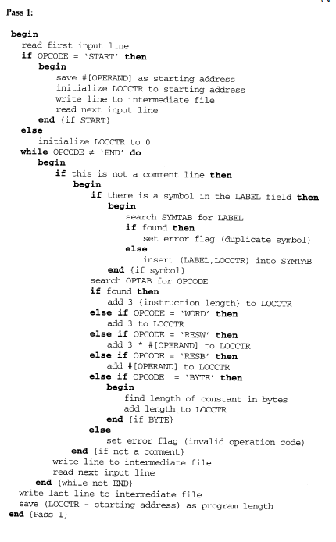

Slide 27
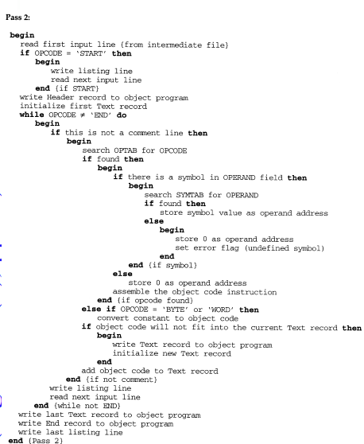

Slide 28
Example program
SUM START 1000
FIRST LDX ZERO
LDA ZERO
LOOP ADD TABLE,X
TIX COUNT
JLT LOOP
STA TOTAL
RSUB
TABLE RESW 2000
COUNT RESW 1
ZERO WORD 0
TOTAL RESW 1
END FIRST

Slide 29
Example program
1000 SUM START 1000
1000 FIRST LDX ZERO
1003 LDA ZERO
1006 LOOP ADD TABLE,X
1009 TIX COUNT
100C JLT LOOP
100F STA TOTAL
1012 RSUB
1015 TABLE RESW 2000
1018 COUNT RESW 1
101B ZERO WORD 0
101E TOTAL RESW 1
1021 END FIRST

Slide 30
OPTAB
Mnemonic | Opcode
LDX | 04
LDA | 00
ADD | 18
STA | 0C
RSUB | 4C
TIX | 2C
JLT | 38
SYMTAB
Name | LOCCTR
FIRST | 1000
LOOP | 1006
TABLE | 1015
COUNT | 1018
ZERO | 101B
TOTAL | 101E

Slide 31
Machine Dependent Assembler Features
instruction formats and addressing modes
program relocation

Slide 32
Machine-dependent Assembler Features
Instruction formats and addressing modes
Program relocation

Slide 33
Instruction Format and Addressing Mode
SIC/XE
PC-relative or Base-relative addressing: op m
Indirect addressing:(avoids another instruction)op @m
Immediate addressing(no memory fetch) op #c
Extended format: +op m
(programs responsibility to specify this mode when required)
Index addressing: op m,x
register-to-register instructions in place of reg-to-memory
larger memory -> multi-programming (program allocation)
BASE is used in conjunction with base relative address

Slide 34
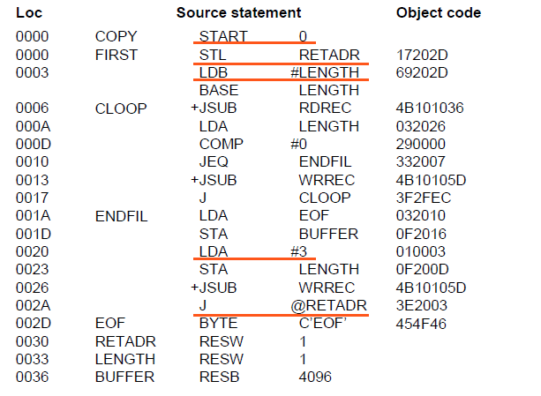
An SIC/XE Example

Slide 35
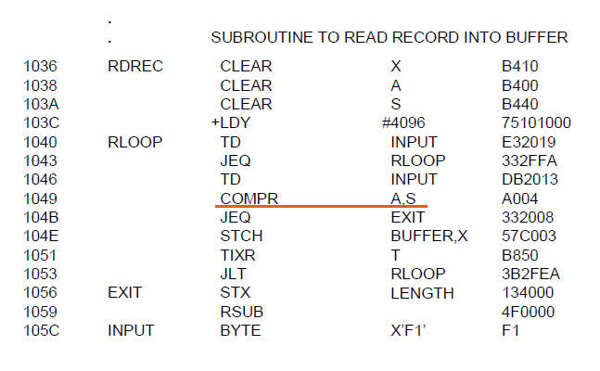

Slide 36
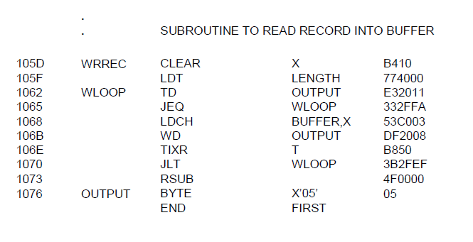

Slide 37
PC-Relative Addressing Modes
PC-relative
10 0000 FIRST STL RETADR 17202D
(14)₁₆ 1 1 0 0 1 0 (02D) ₁₆
displacement= RETADR - PC = 30-3 = 2D
40 0017 J CLOOP 3F2FEC
(3C)₁₆ 1 1 0 0 1 0 (FEC) ₁₆
displacement= CLOOP-PC= 6 - 1A= -14= FEC

Slide 38
Base-Relative Addressing Modes
Base-relative
base register is under the control of the programmer
12 LDB #LENGTH
13 BASE LENGTH
160 104E STCH BUFFER, X 57C003
( 54 )₁₆ 1 1 1 1 0 0 ( 003 ) ₁₆
(54) 1 1 1 0 1 0 0036-1051= -101B₁₆
displacement= BUFFER - B = 0036 - 0033 = 3
NOBASE is used to inform the assembler that the contents of the base register no longer be relied upon for addressing

Slide 39
Immediate Address Translation
Immediate addressing
55 0020 LDA #3 010003
( 00 )₁₆ 0 1 0 0 0 0 ( 003 ) ₁₆
133 103C +LDT #4096 75101000
( 74 )₁₆ 0 1 0 0 0 1 ( 01000 ) ₁₆

Slide 40
Immediate Address Translation (Cont.)
Immediate addressing
12 0003 LDB #LENGTH 69202D
( 68)₁₆ 0 1 0 0 1 0 ( 02D ) ₁₆
( 68)₁₆ 0 1 0 0 0 0 ( 033)₁₆ 690033
the immediate operand is the symbol LENGTH
the address of this symbol LENGTH is loaded into register B
LENGTH=0033=PC+ displacement = 0006+02D
if immediate mode is specified, the target address becomes the operand

Slide 41
Indirect Address Translation
Indirect addressing
target addressing is computed as usual (PC-relative or BASE-relative)
only the n bit is set to 1
70 002A J @RETADR 3E2003
( 3C )₁₆ 1 0 0 0 1 0 ( 003 ) ₁₆
TA=RETADR=0030
TA=(PC)+disp=002D+0003

Slide 42
Program Relocation
More than one program share the memory
In advance programs running concurrently??
Then we would load without overlap or waste of space
But not practical to plan program execution (jobs summited nor time)
So load whenever there is room in memory
Then actual staring address is not known until loads time.

Slide 43
Program Relocation
Example
Absolute program, starting address 1000
e.g. 55 101B LDA THREE 00102D
Relocate the program to 2000
e.g. 55 101B LDA THREE 00202D
Each Absolute address should be modified
Example
Except for absolute address, the rest of the instructions need not be modified
not a memory address (immediate addressing)
PC-relative, Base-relative
The only parts of the program that require modification at load time are those that specify direct addresses

Slide 44
Program Relocation
Eg SIC absolute program
Line 55 00102D
Load at 2000
Then 102D will not contain the value needed
Assembler doesn’t know the actual address, so it cannot make the changes
But identification and modification can be told by the assembler to loader
An object program containing modification information is relocatable program

Slide 45
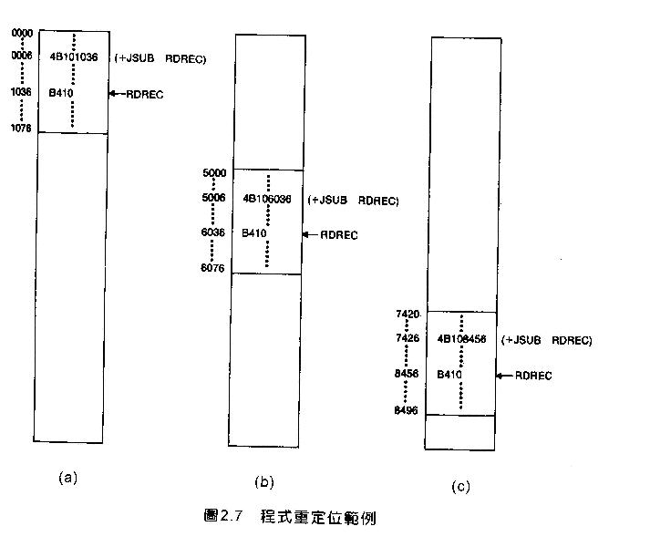
Example SIC/XE

Slide 46
Relocatable Program
Modification record
Col 1 M
Col 2-7 Starting location of the address field to be modified, relative to the beginning of the program
Col 8-9 length of the address field to be modified, in half- bytes

Slide 47
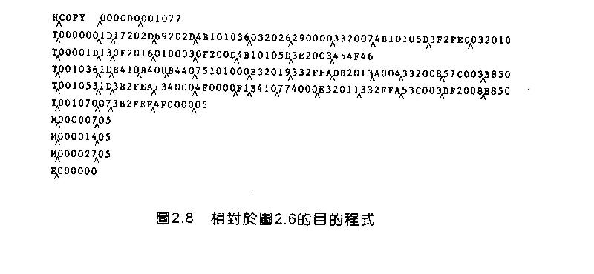
Object Code

Slide 48
End of Chapter 02
Assembler

